Slide 1
CHAPTER 5 Predictive Control with constraints 6 Constraints in DMC approaches
Anthony Rossiter

Slide 2
Background
So far the constraint code and development has focussed on a simple GPC algorithm.
However, it was noted in chapter 2 that DMC is popular in industry so it would be useful to see how the implementation would differ for this algorithm.
As in the previous video, the viewer will note that the key difference with GPC is how the difference in the predictions affects both he performance index and the constraints.

Slide 3
GPC optimisation
GPC control law is defined by the following cost function, predictions and constraints.

Slide 4
Changes with a DMC
The main change is the modification of the prediction equations (see chapter 2).
Note it is a different ‘P’ in each of these equations.
GPC
DMC
Substituting in different prediction matrices is straightforward

Slide 5
Performance index
This is written as follows:
Only change is how parameter a is computed at each sample.

Slide 6
Constraint inequalities
Constraints over the prediction horizon can be represented as:
Only change is in the output constraints part of the inequalities.

Slide 7
DMC optimisation
GPC control law is defined by the following QP optimisation.

Slide 8
Summary
This video has shown how constraints can be incorporated into a DMC algorithm.
MATLAB code is NOT provided, although viewers should easily be able to edit the existing code should they want this.
The only substantive change from GPC is the change in the prediction equations so that wherever ‘P’ appears, a different P is now required (see chapter 2 for details), and Q is changed to L.

Slide 9



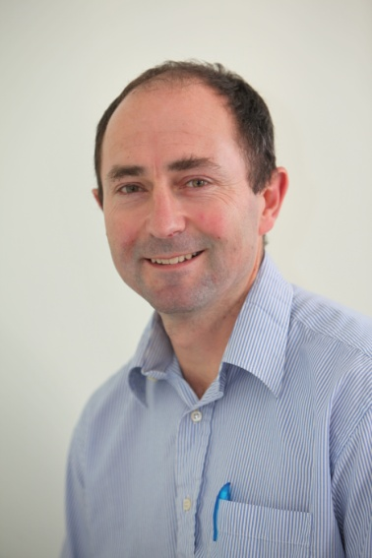
Anthony Rossiter
Department of Automatic Control and Systems Engineering
University of Sheffield
www.shef.ac.uk/acse
© 2014 University of Sheffield
This work is licensed under the Creative Commons Attribution 2.0 UK: England & Wales Licence. To view a copy of this licence, visit http://creativecommons.org/licenses/by/2.0/uk/ or send a letter to: Creative Commons, 171 Second Street, Suite 300, San Francisco, California 94105, USA.
It should be noted that some of the materials contained within this resource are subject to third party rights and any copyright notices must remain with these materials in the event of reuse or repurposing.
If there are third party images within the resource please do not remove or alter any of the copyright notices or website details shown below the image.
(Please list details of the third party rights contained within this work.
If you include your institutions logo on the cover please include reference to the fact that it is a trade mark and all copyright in that image is reserved.)

